Slide 1

sorry
By Ellice, Kris, Jack, David and Cal

Slide 2
Breakdown of work
Cal- Game Developer and Audio Implementation
David - Sound Designer
Ellice - Sound Designer
Jack - Composer
Kristian - Project Manager, Sound Design and Audio Implementation.

Slide 3
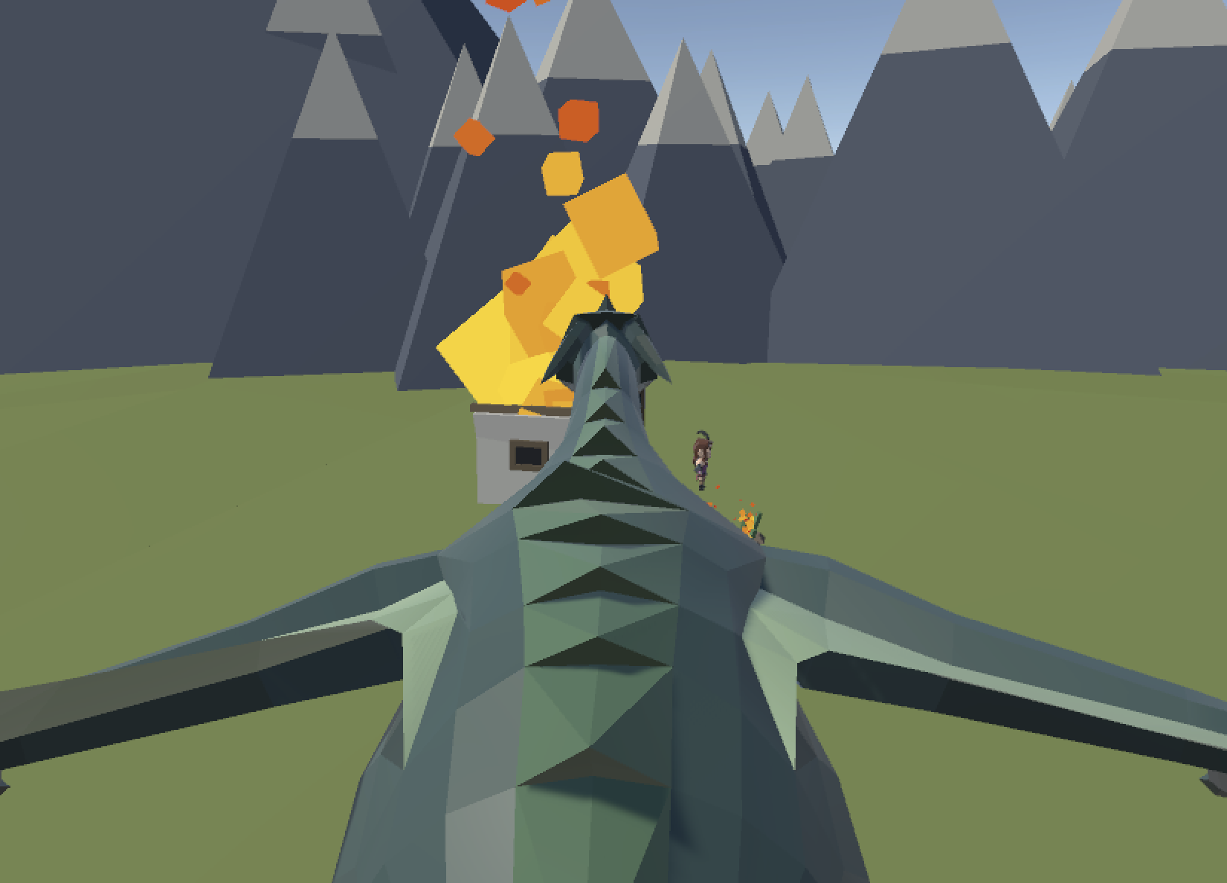
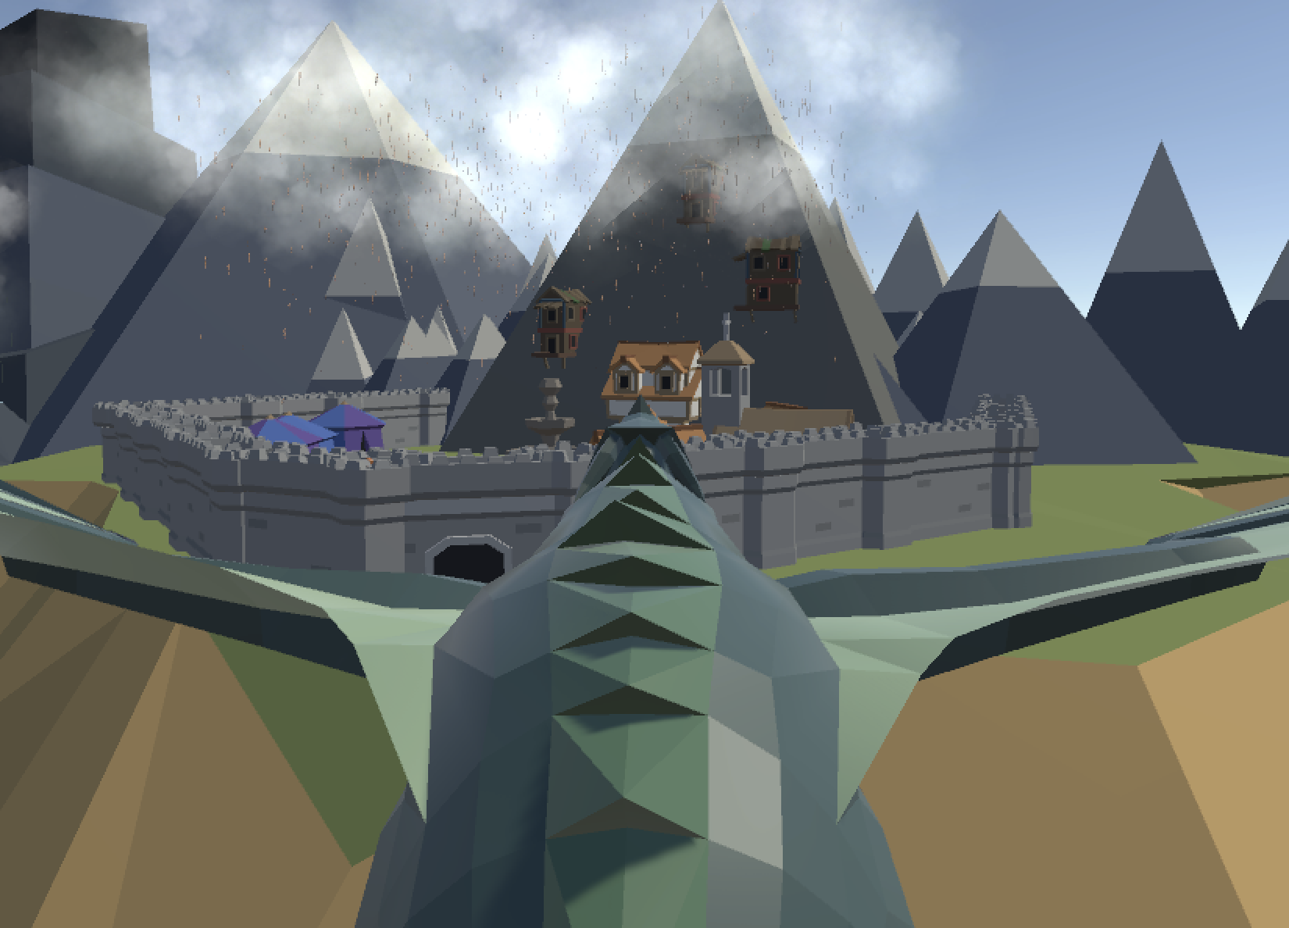
Development Process
The game created for this project was dragon simulator, an open world sandbox game made in unity. Playing as a dragon burning down villages.
Unfortunately, time constraints and game scope was too wide in development. Which has reduced game mechanics to focus on audio interactions.
This was done by keeping in the main aspects of the game of the interaction with the environment, player controls and movement and the the npcs within the game that have been reduced down from small army of villagers with different weapons to archers.
The game has been created within unity due to past knowledge with the game engine and the compatibility with Fmod studios.

Slide 4
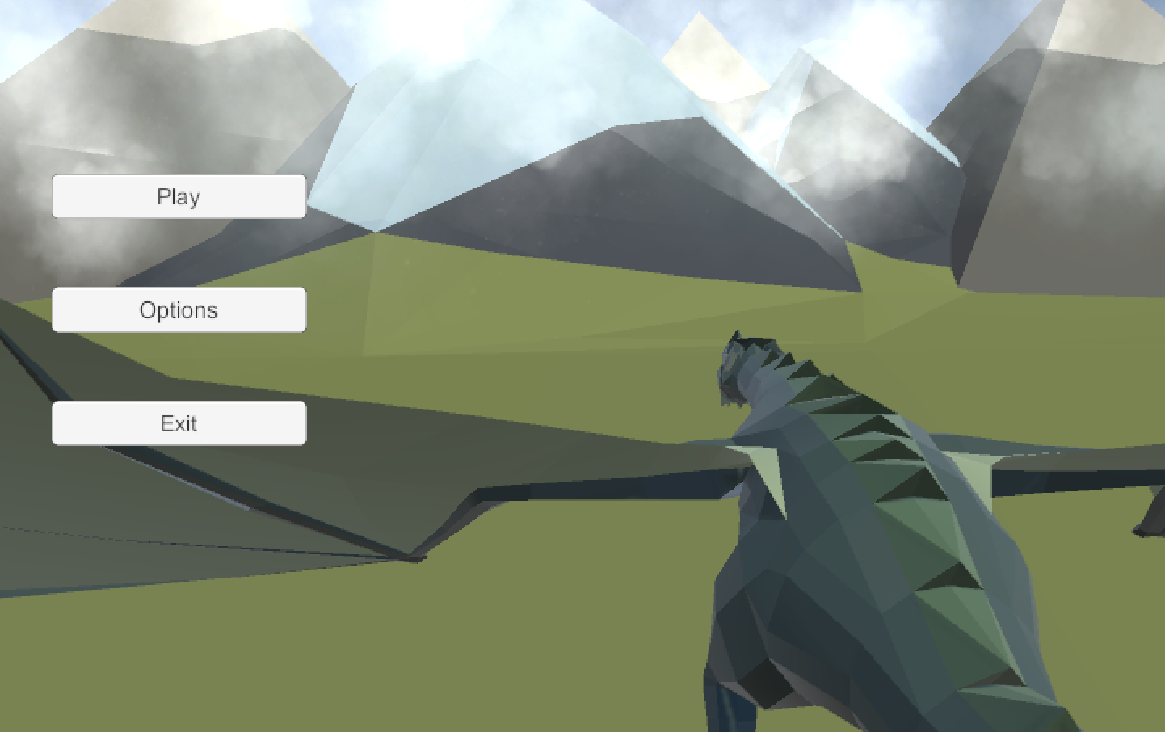
Menu Sound and Implementation
Three 2D fmod events
Hover, Click, and a failure sound for the options page (No options page).
Hover and Click are just synthesised Ableton.
Using Randomisation of volume and Pitch in fmod.
Effects processes for comedic effect.
The failure sound is a text to speech engine saying “Negazione”.
Using a Flanger to impart a similar comedic tone.

Slide 5
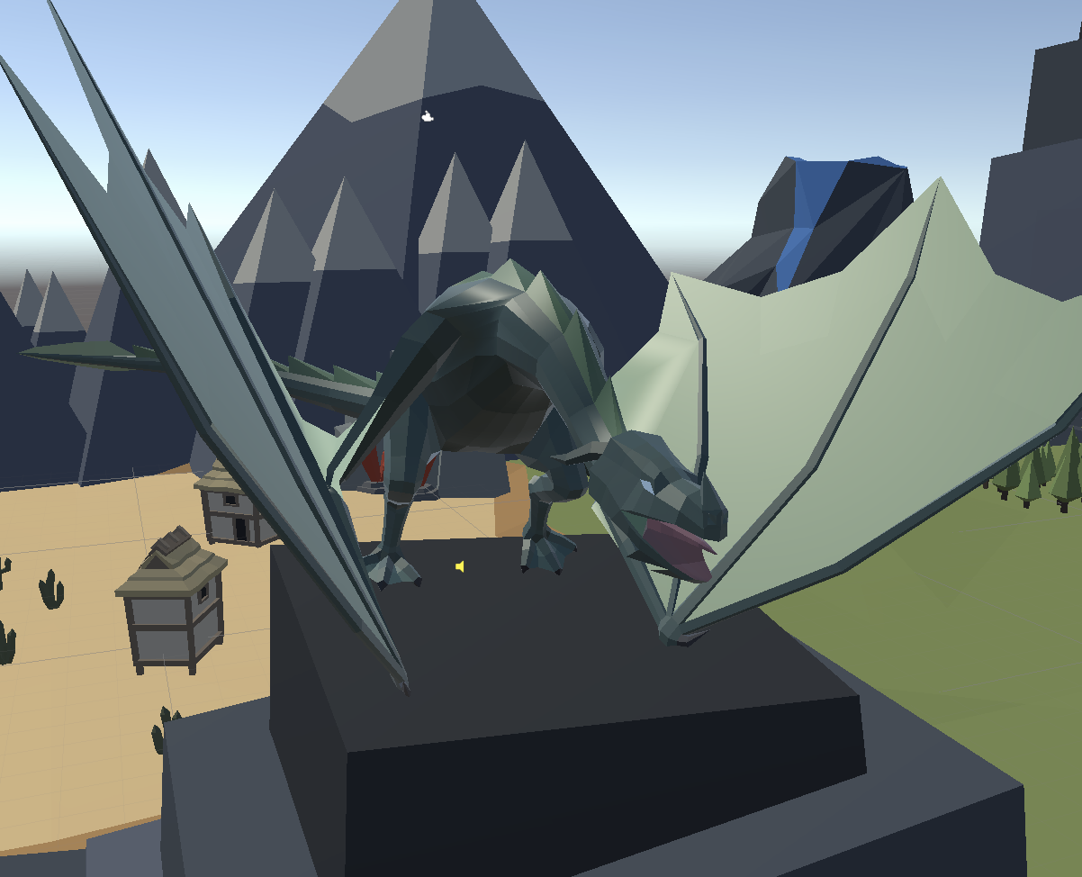
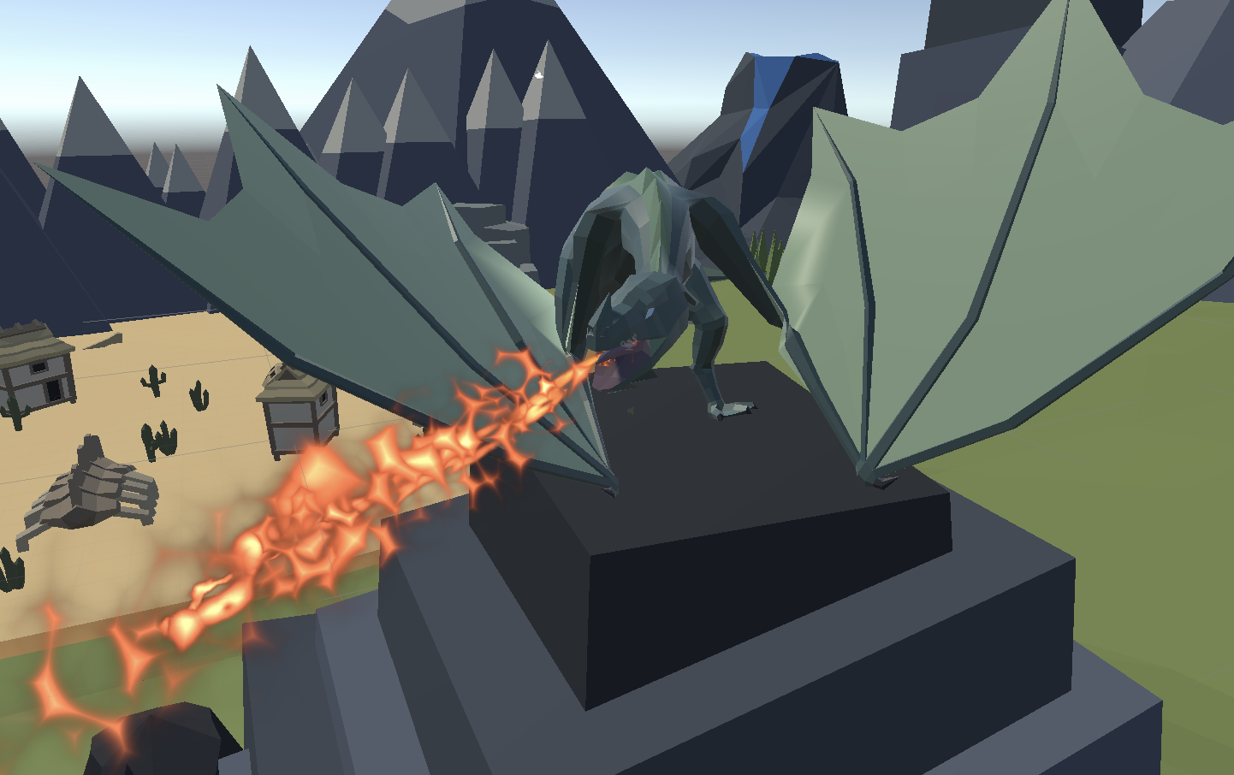
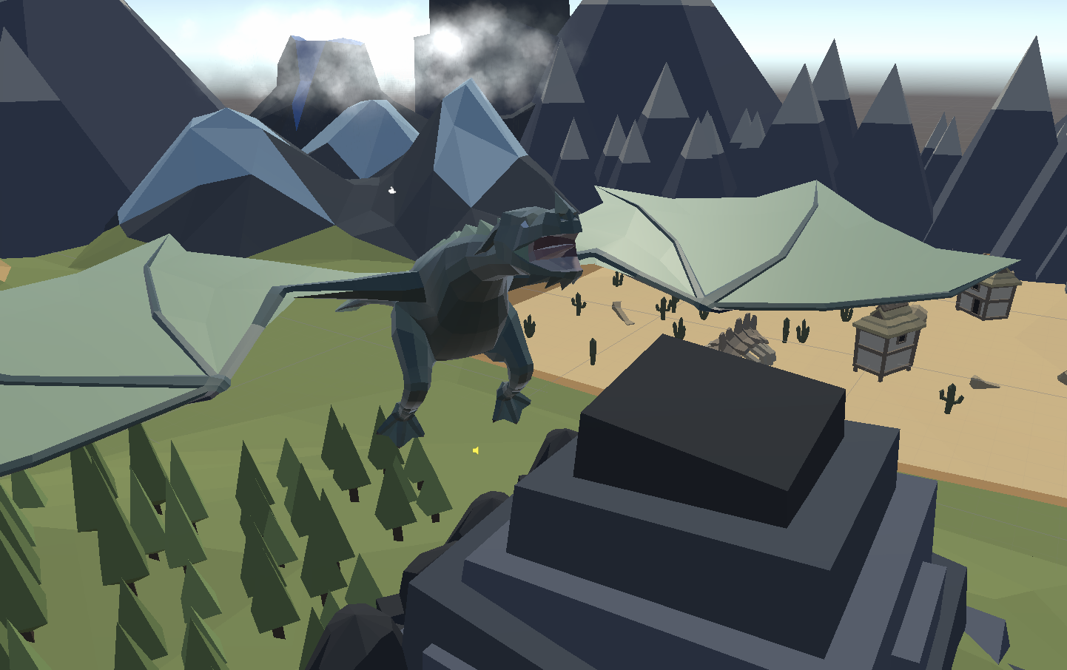
Character Sonification and Implementation
Sounds linked to animation of dragon:
Walking (Different sounds per surface)
Fire
Wings with up and down being different sounds.
Collisions with objects in the environment use layers to trigger different sounds in the game.
Dragon dialogue uses a cooldown timer for different lines with the height variable changing the dialogue because of altitude sickness.
Global parameters sent through are Dragon Speed and Height.
Issues with landing so no footsteps.

Slide 6
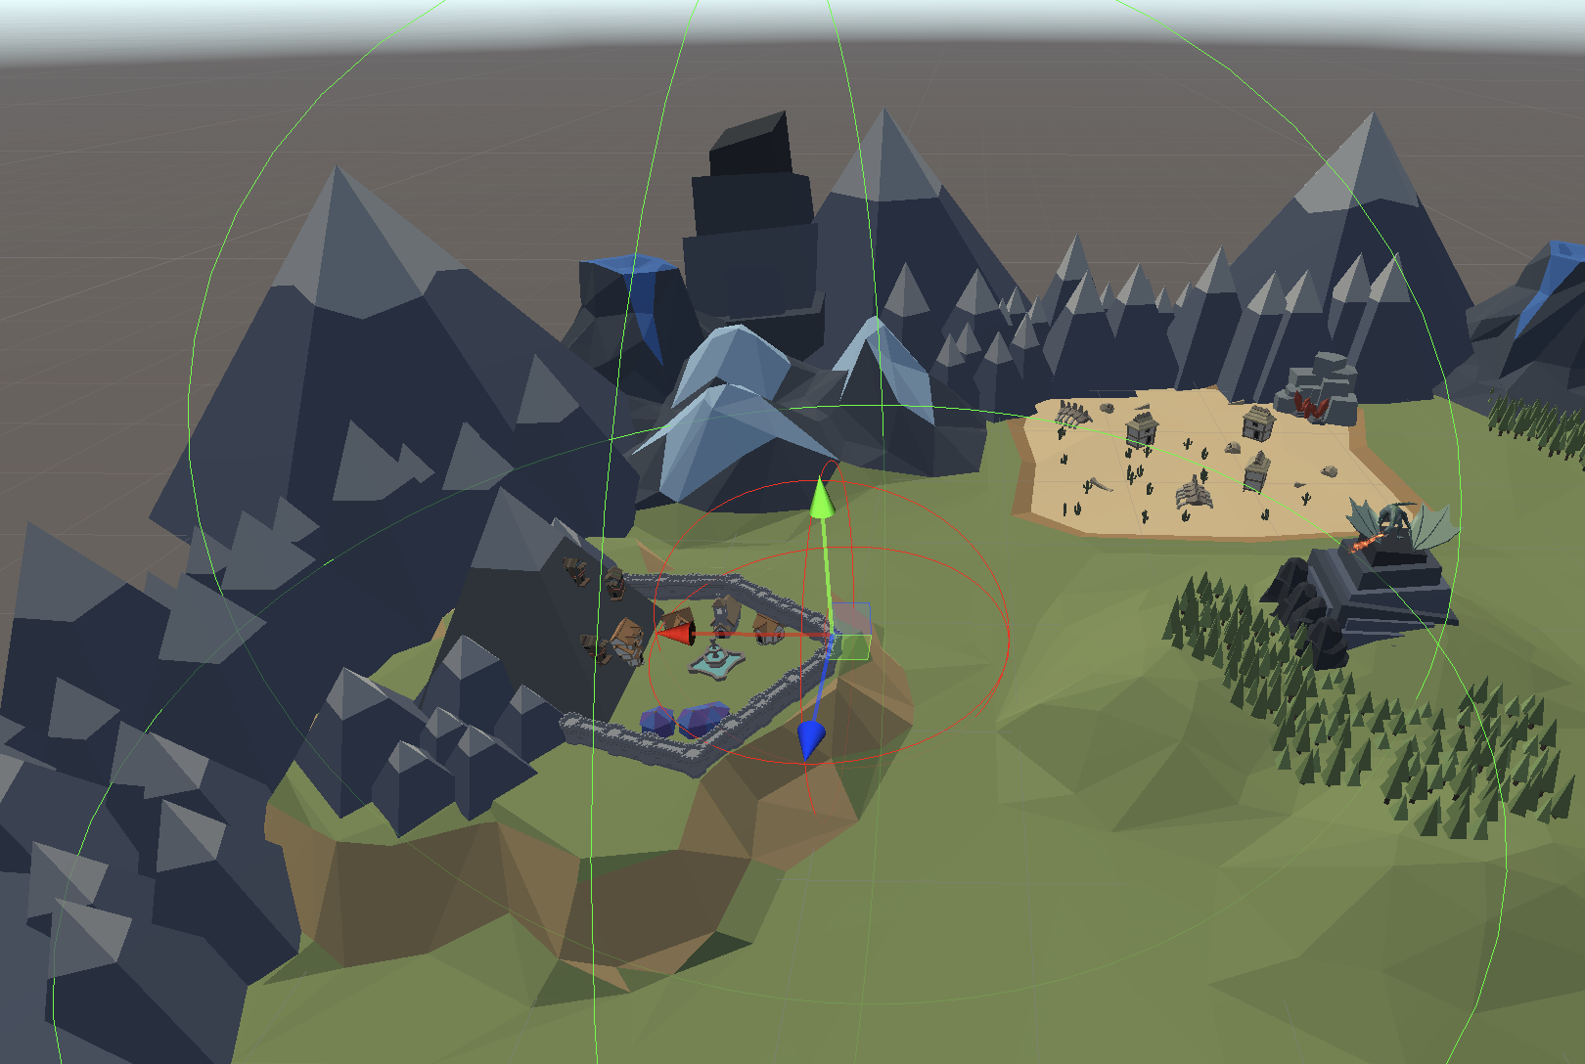
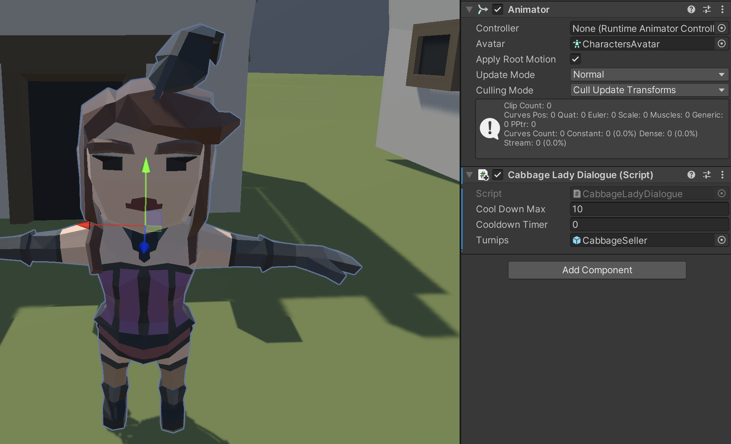
NPC Interactions
We may have went overboard on NPC recording.
Turnip lady dialogue tree implemented, but no data being passed through to the FMOD for changing lines.
Archer sounds were tied to the animation of the archer using area detection.
Area detection used to trigger the village Alert when in sight range (horn and shout).
Villager Pain level percentage tied to audio phrases, 0% fighting calls, 100% screams with lots in between. Unimplemented in unity but done in FMOD.

Slide 7
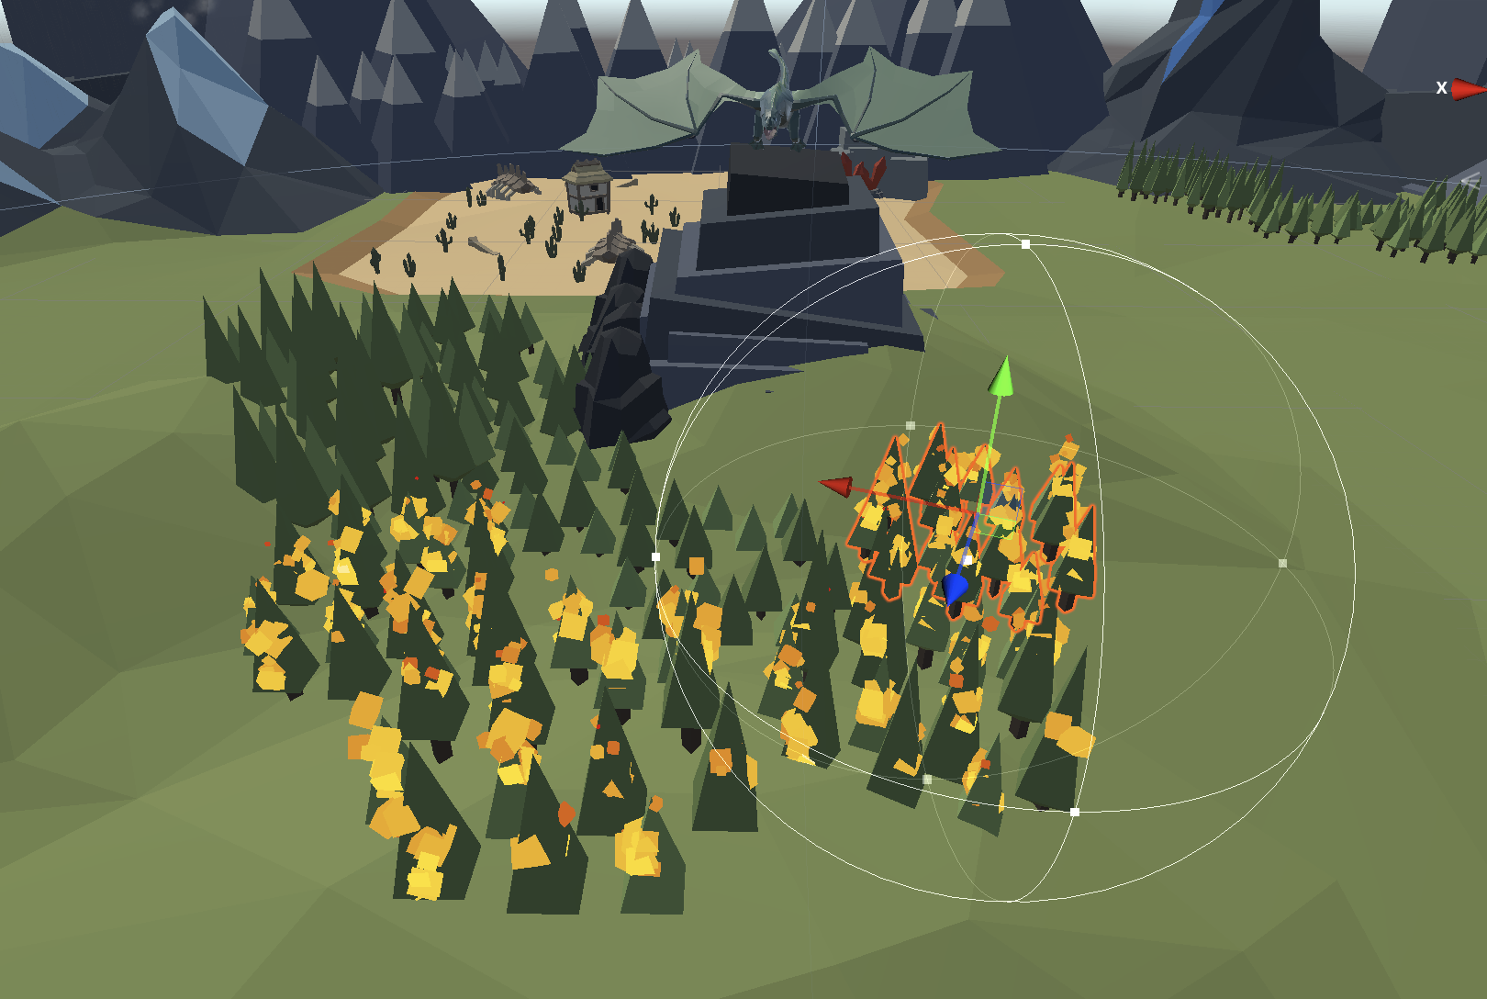
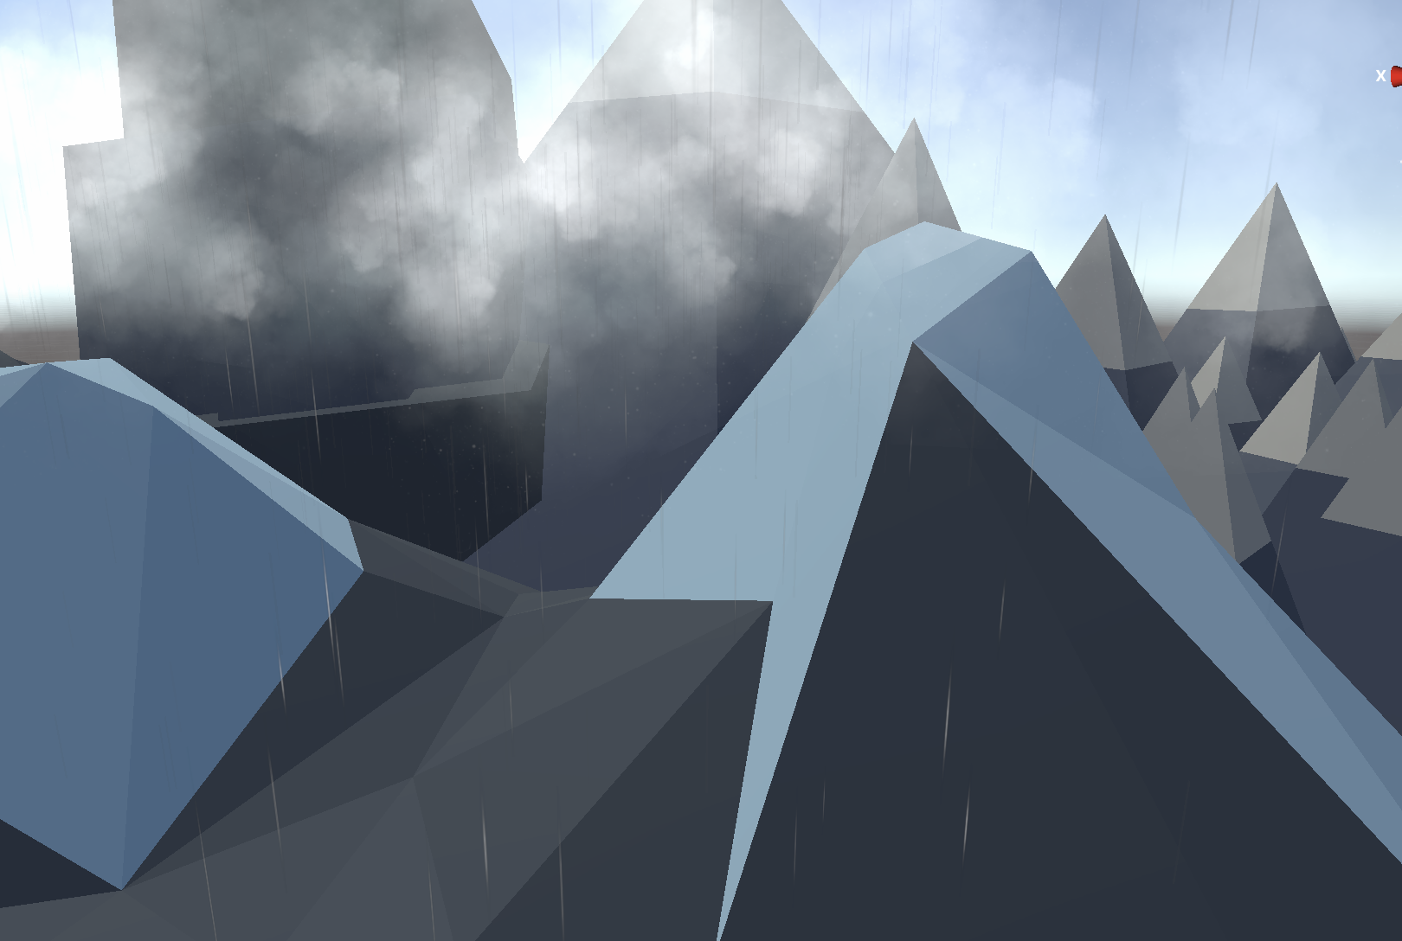
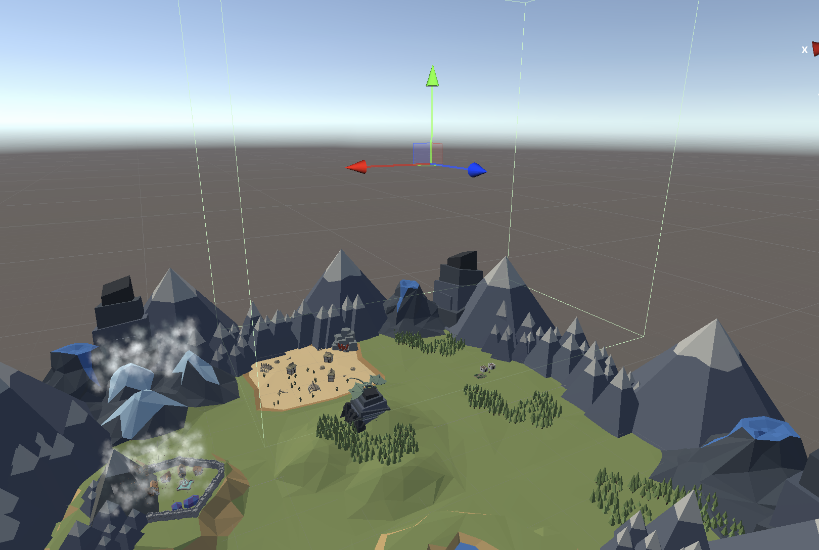
Environmental Sounds
Objects can be set on fire, using pure data to trigger burning and crackling sounds for the object.
Buildings set on fire change the sound of church, circus and water fountain within village.
Rain that is 3d events generated with the particle systems, layered with dripping file and noise. (40% chance of goblin)
There is also bounding box areas uses to change the sound based on the area, this is done by passing a location parameter based on the area.

Slide 8
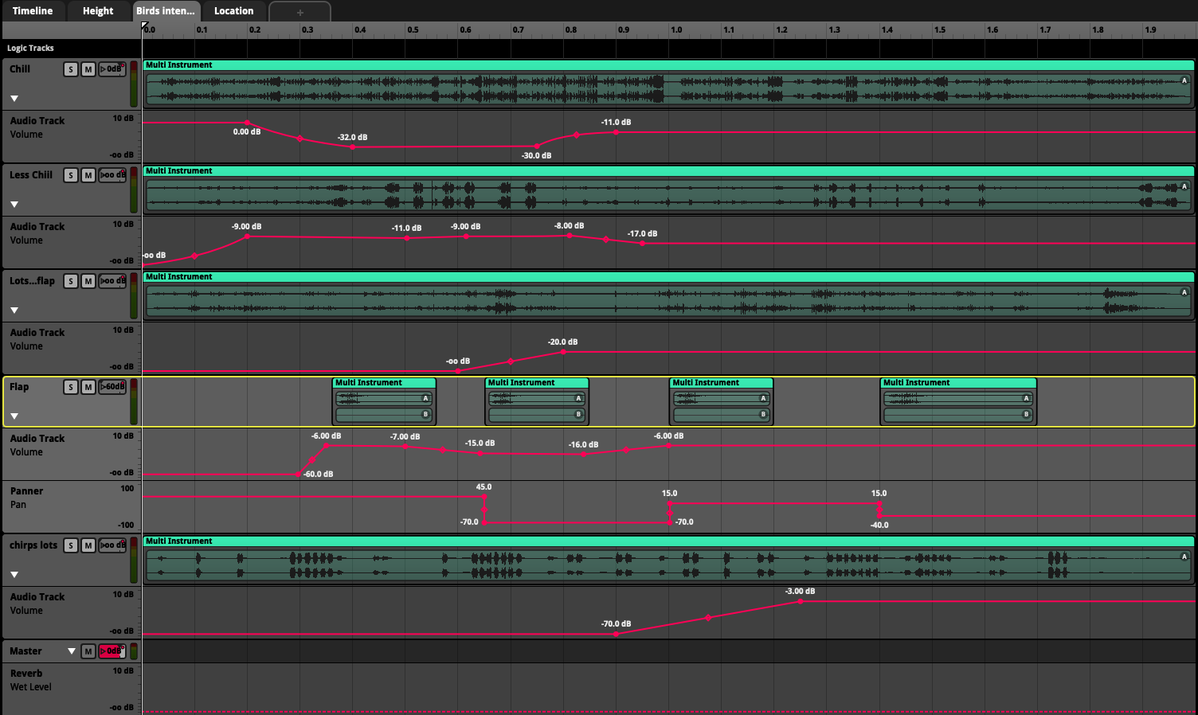
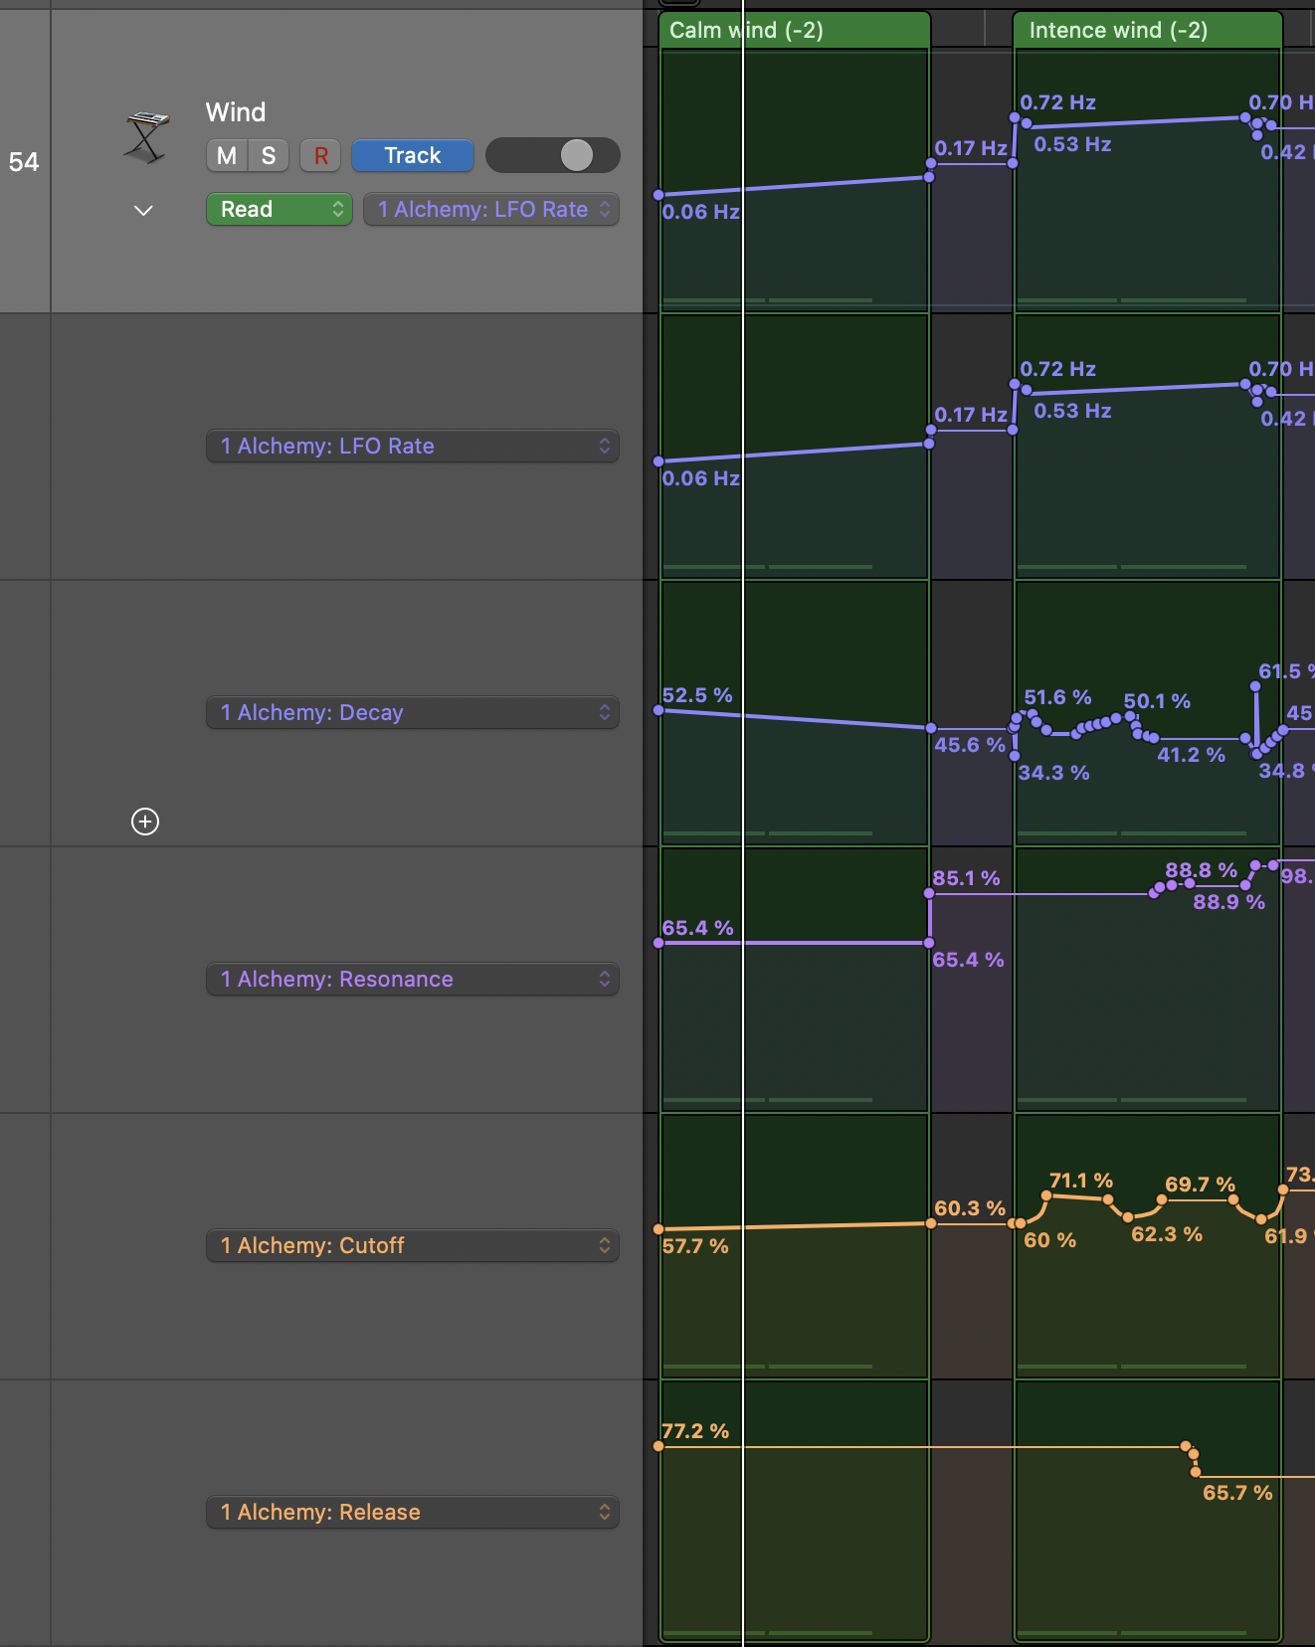
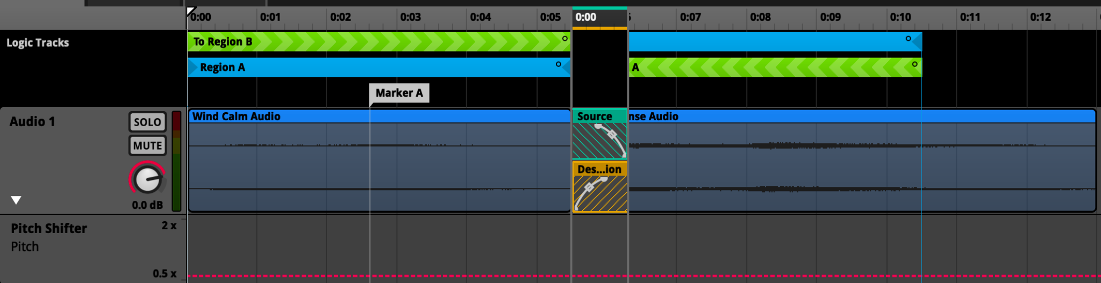
Birds
Birds sounds emitted from trees, using the on fire state to cause birds to scatter and increase the audio intensity to simulate rushing off.
Birds promoters develop and change depending on the duration of the trees being set on fire. This was used with a promoter called intensity, changing the method of the source.
Reverb depending on the distances to the player's character.
Mountains
A range of different types of rocks falling with a 20% chance of a defined impact sound to separate the linearity of it.
Wind that changes depending on environment, using said bounding box areas generated using noise and modulation parameters.
Loops with a fade in and out for smoothness.
Wind
Wind that changes depending on environment, using said bounding box areas generated using noise and modulation parameters.
Two wind sound of different velocity created using synthesizers, which modulate over time.
Transition regions to switch between the two different intensity, using a pitch shift to increase pitch, linked to dragons speed.

Slide 9
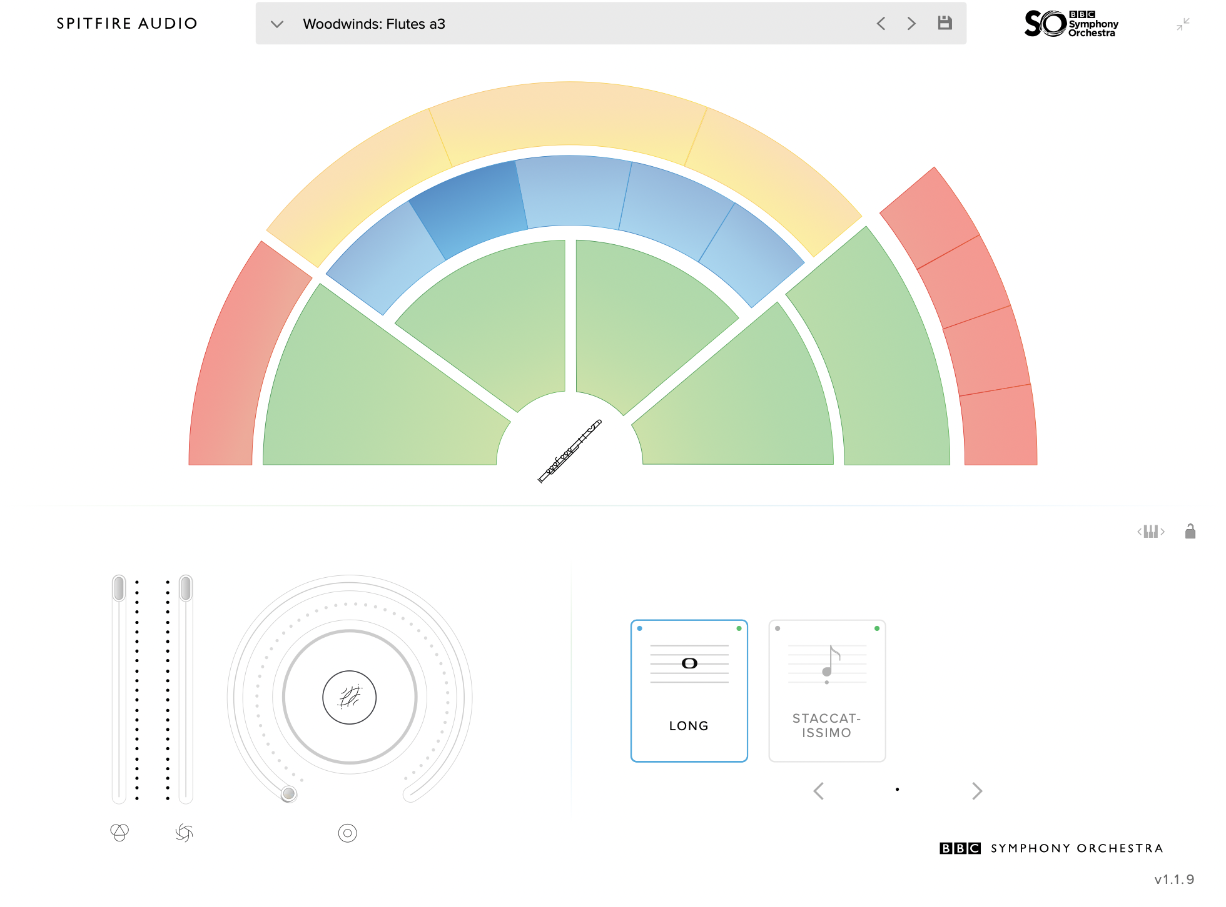
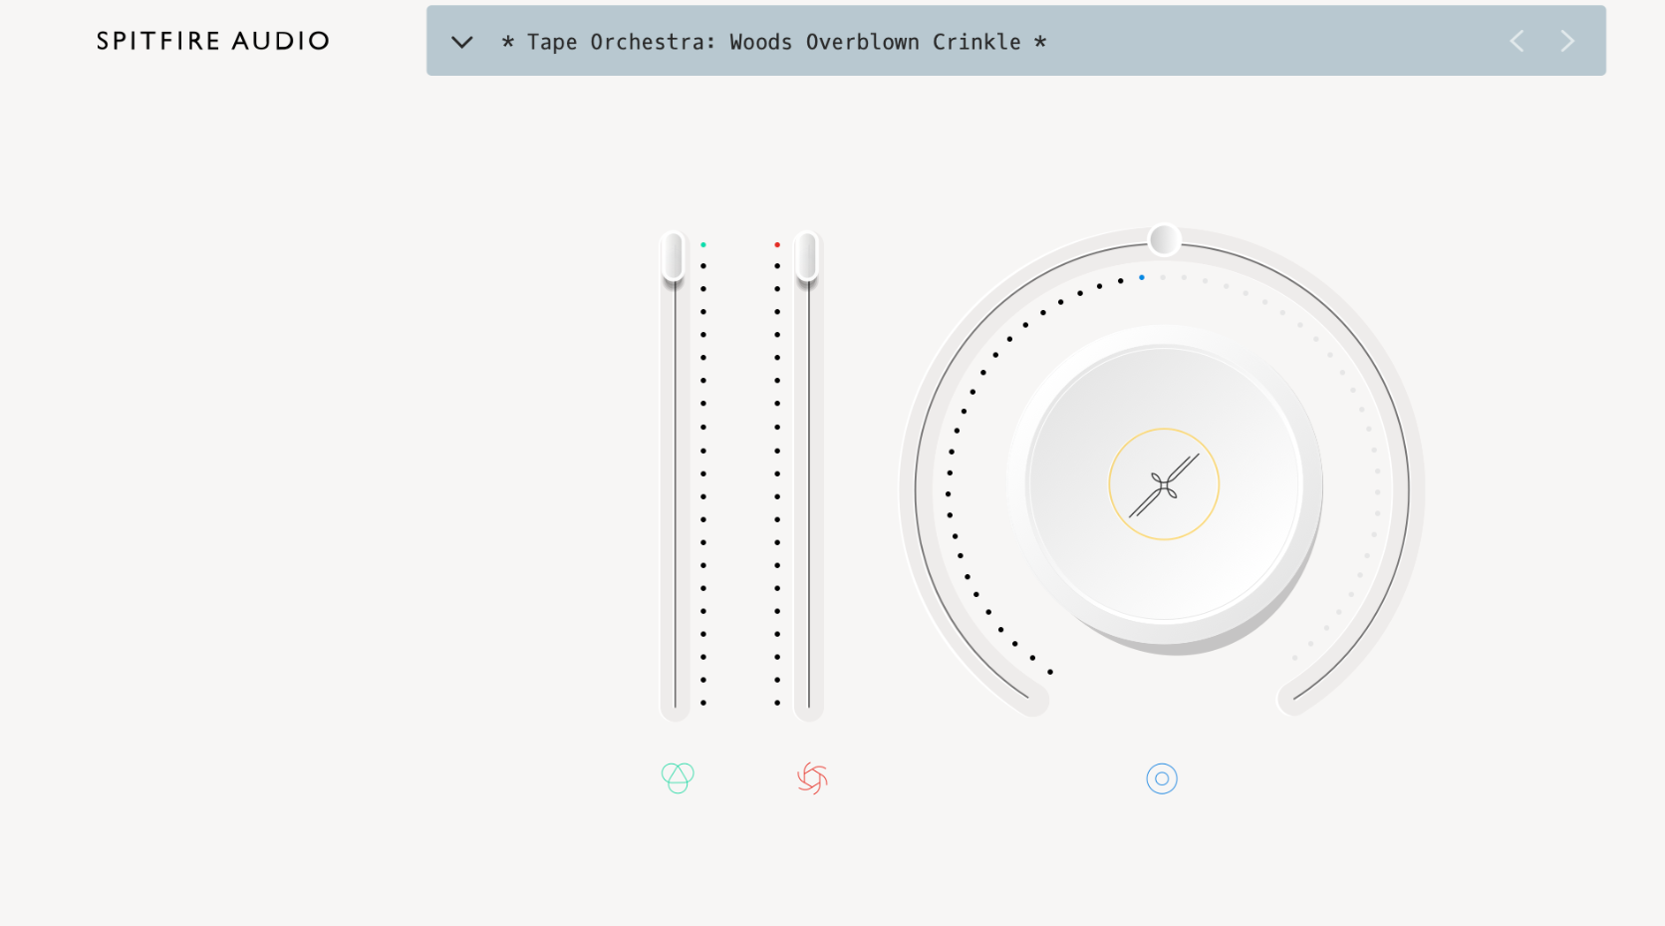
Music - Composition

Slide 10
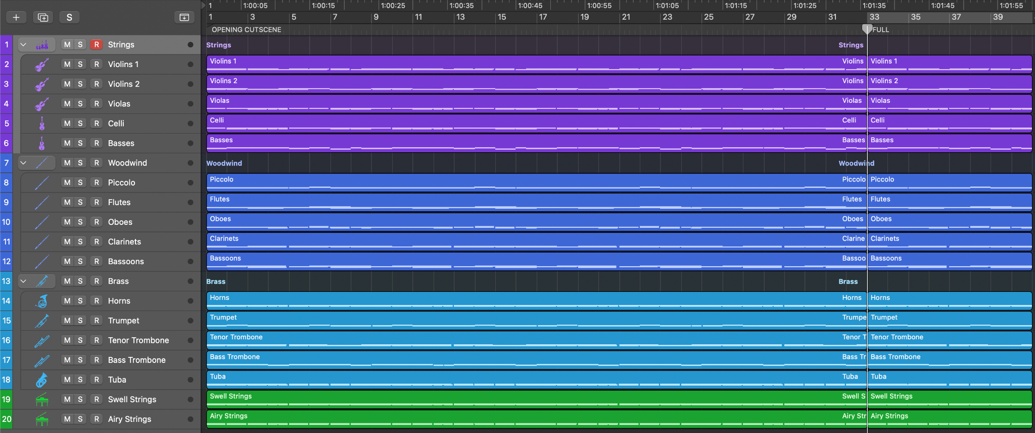
Music - Composition

Slide 11
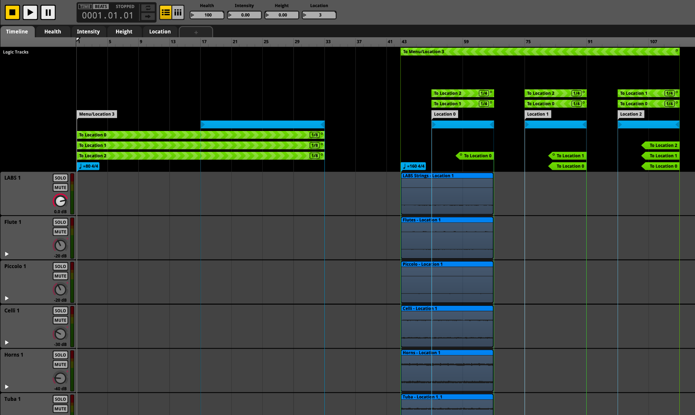
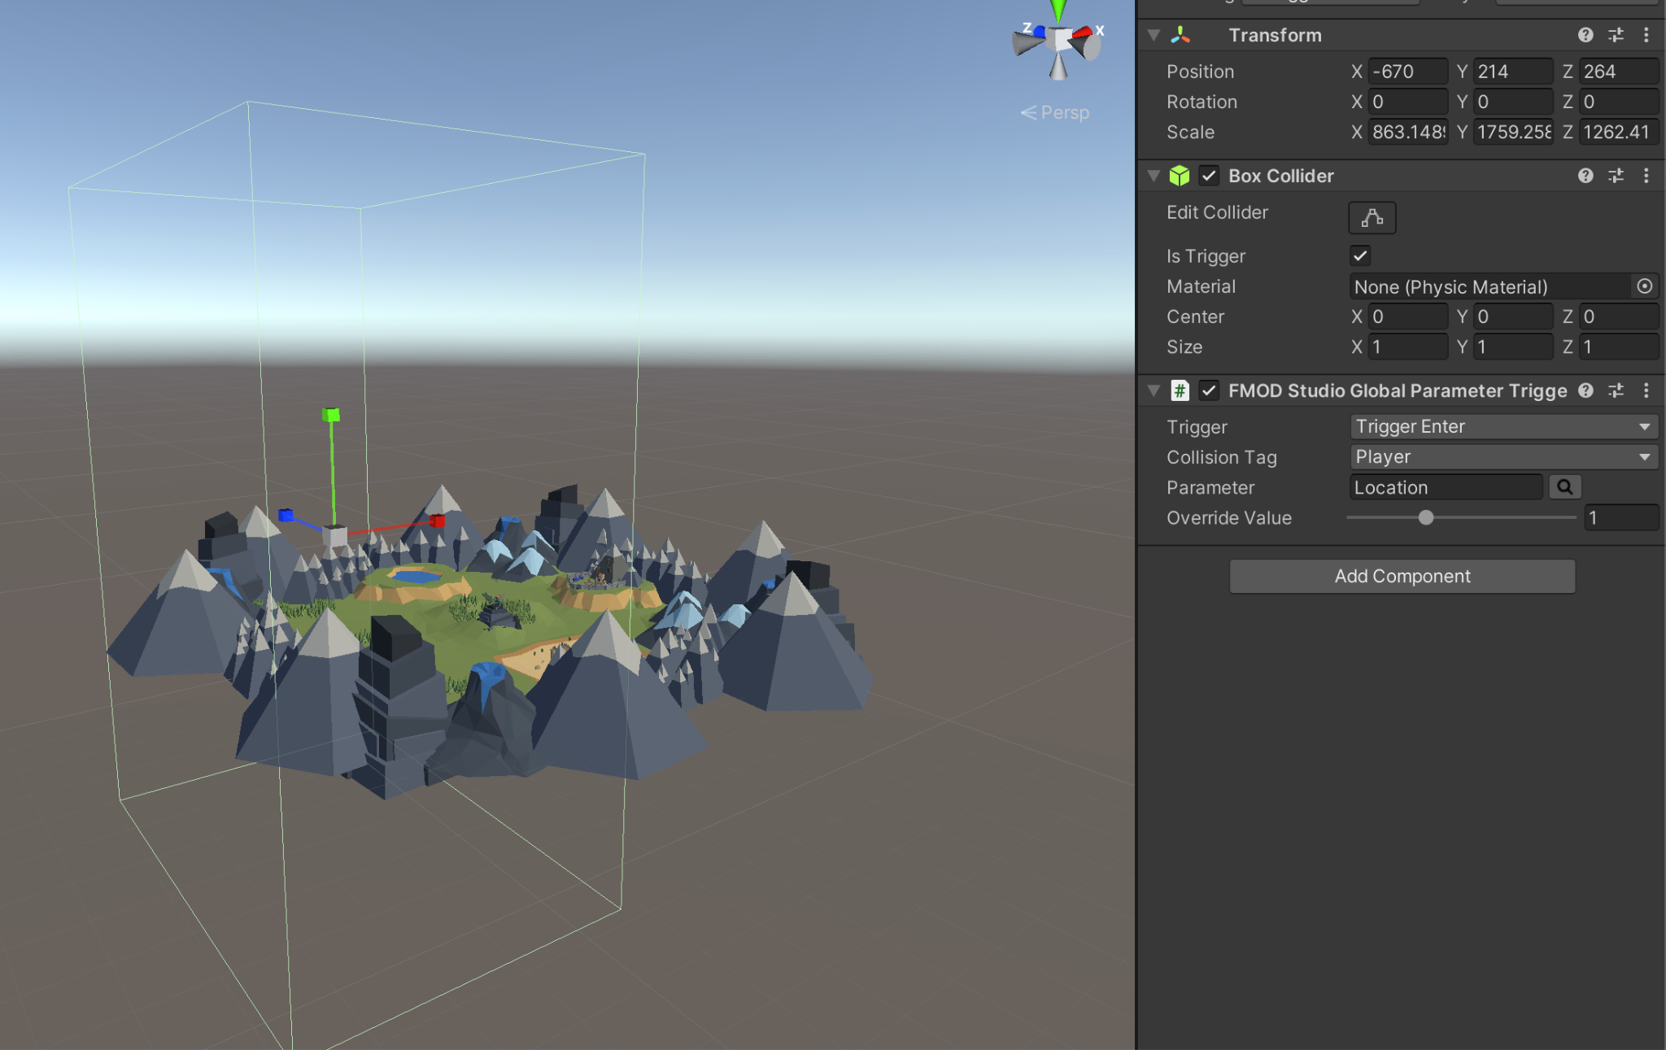
Music - FMOD Location Interaction
Trigger Zones

Slide 12
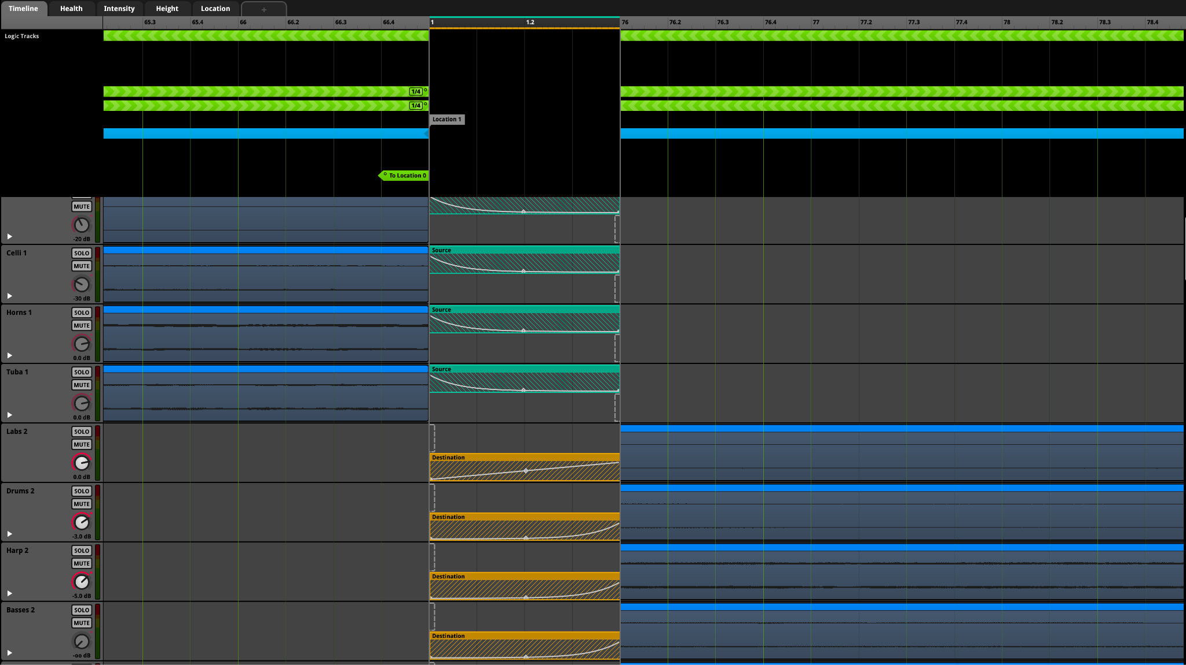
Music - FMOD Location Interaction (Cont.)

Slide 13
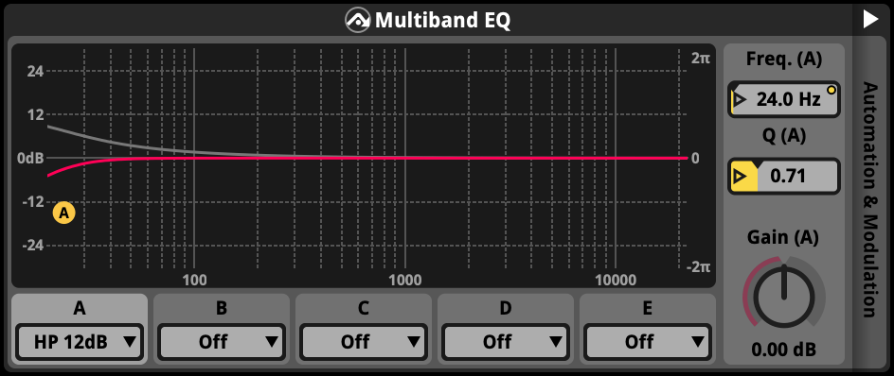
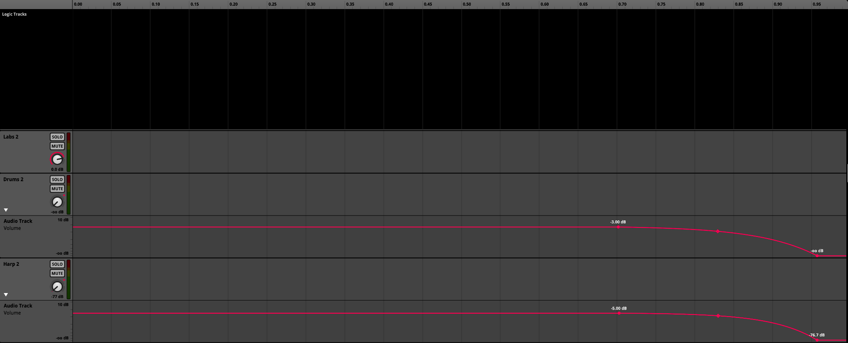
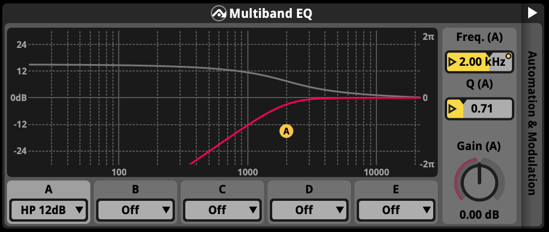
Music - FMOD Height Interaction

Slide 14
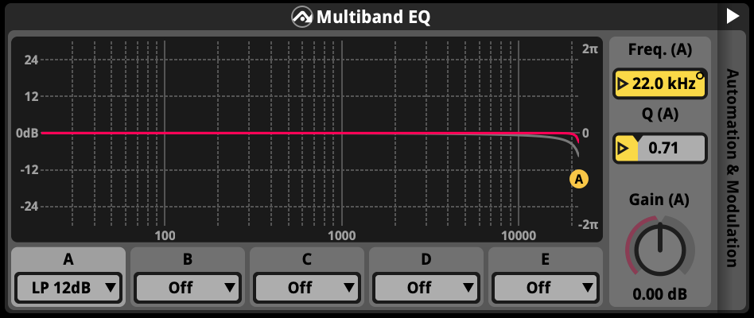
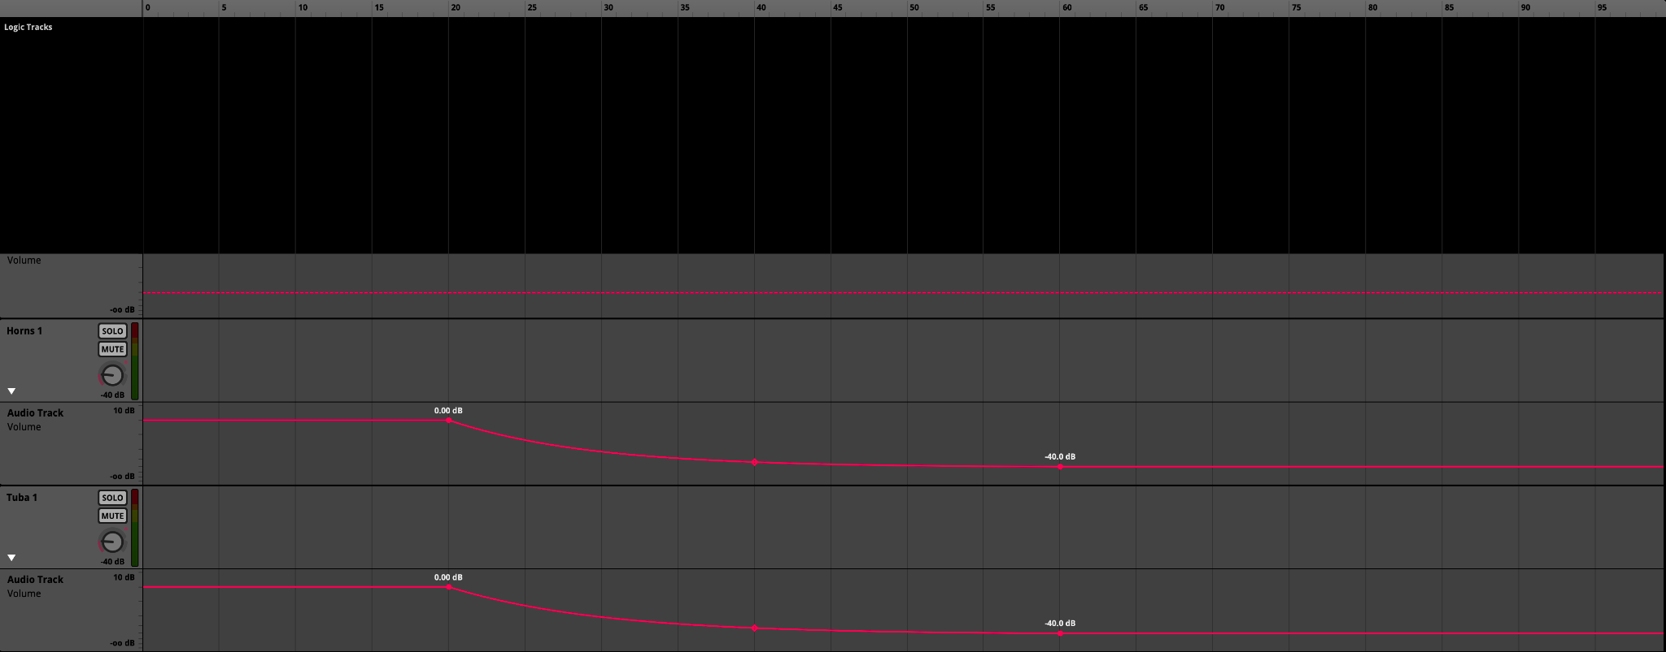
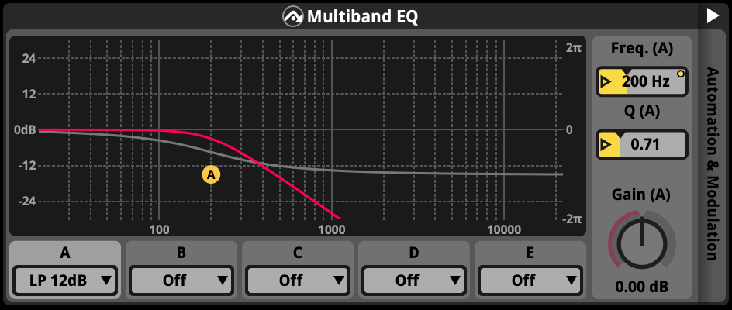
Music - FMOD Health Interaction (Height)

Slide 15
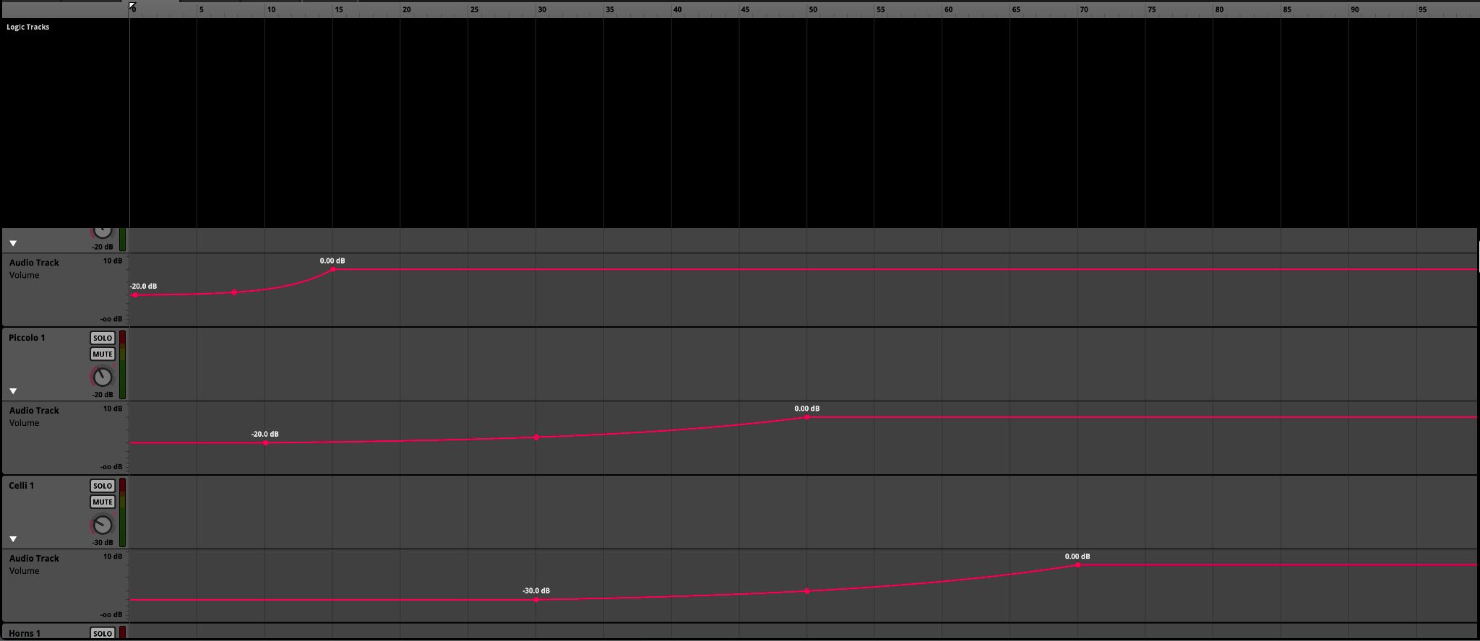
Music - FMOD Intensity Interaction (Speed)

Slide 16
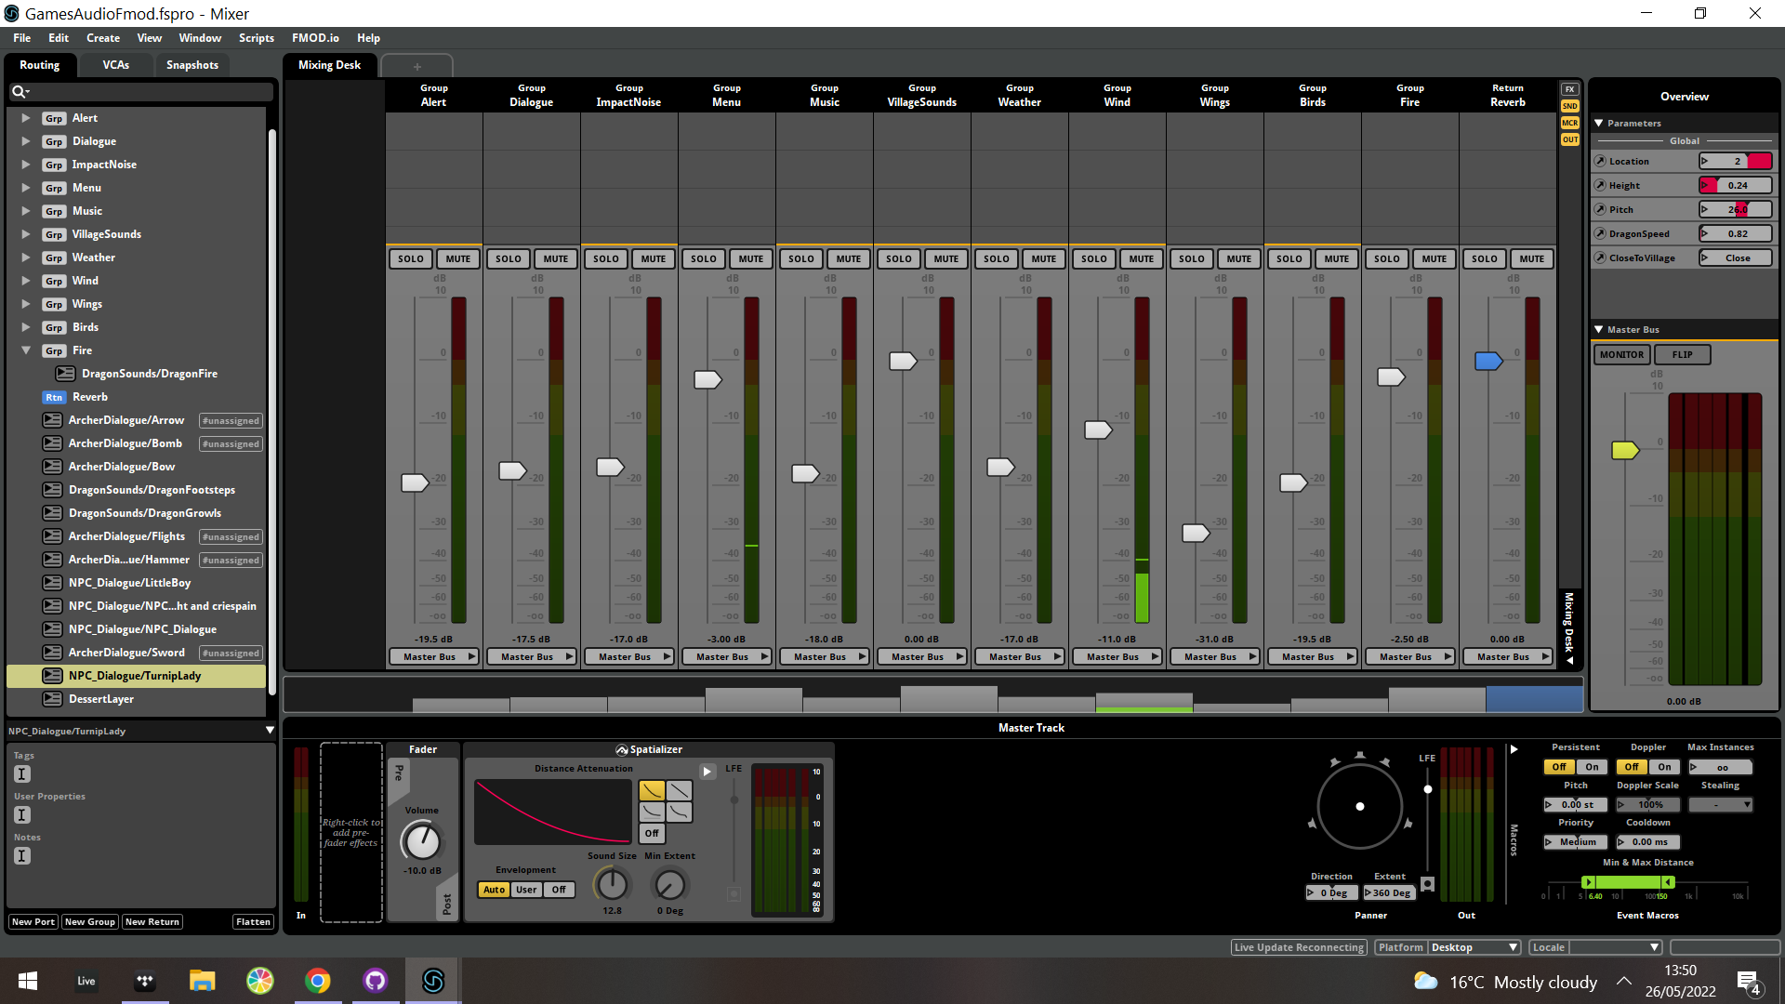
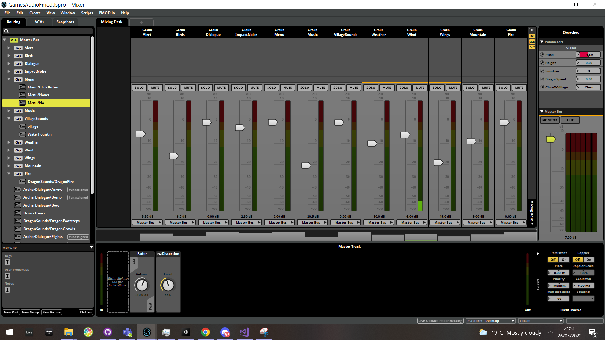
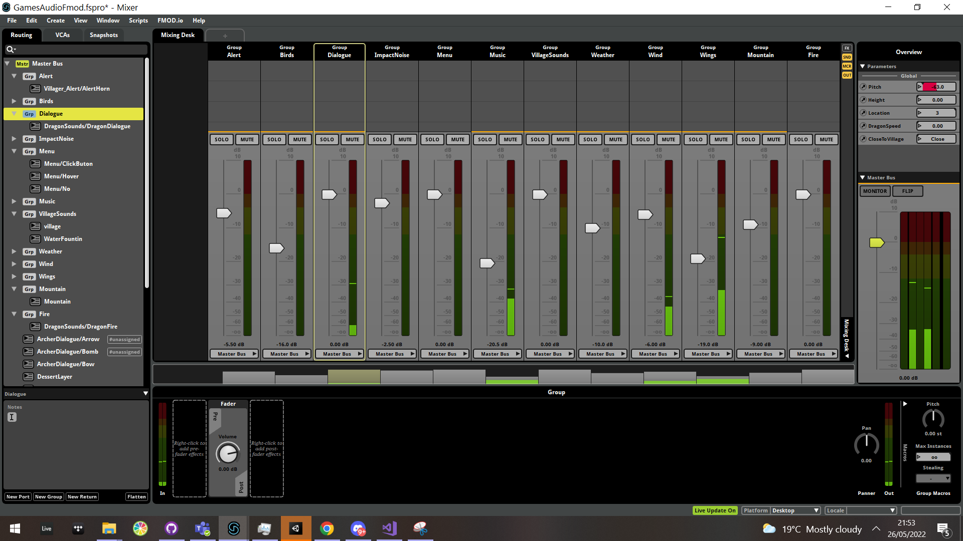
Mixing
Mixing done in the orchard using Live update and grouping events.
Adjustments made as needed.
Events ranges tweeted to ensure that they can be heard.

Slide 17
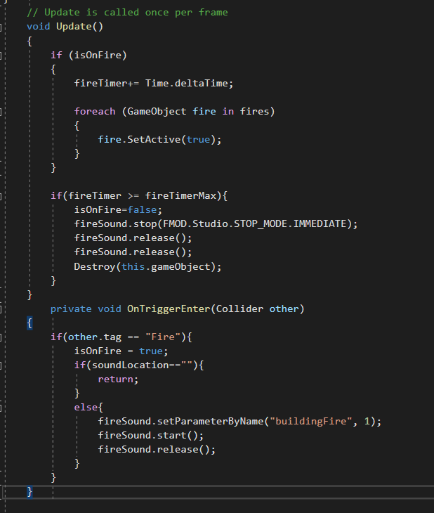
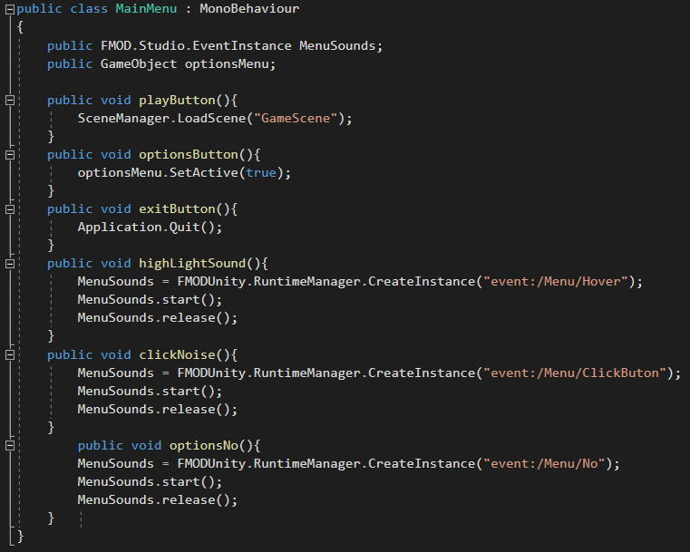
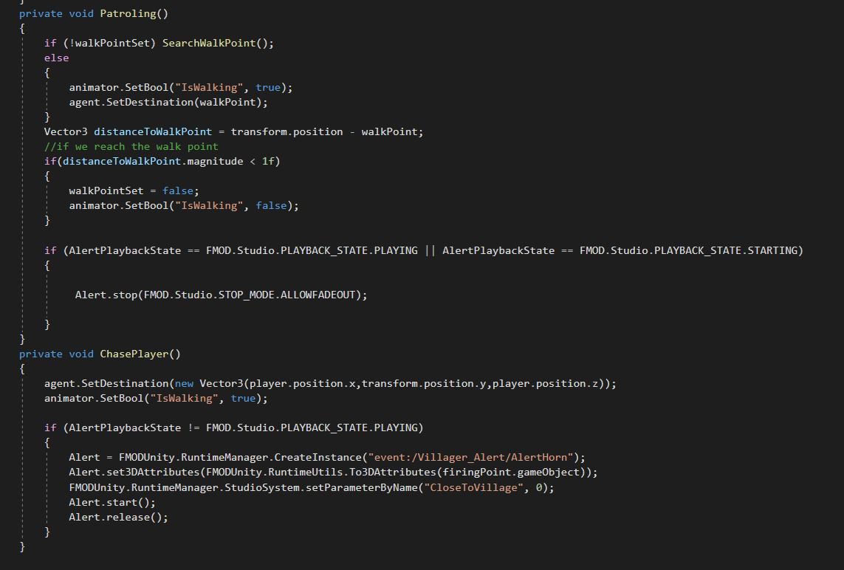
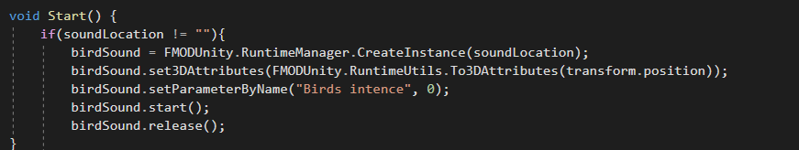
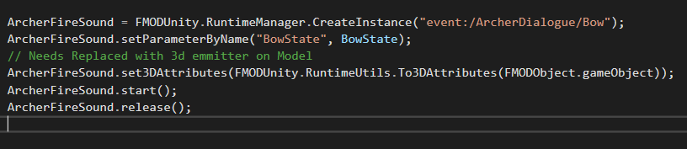
Code

Slide 18
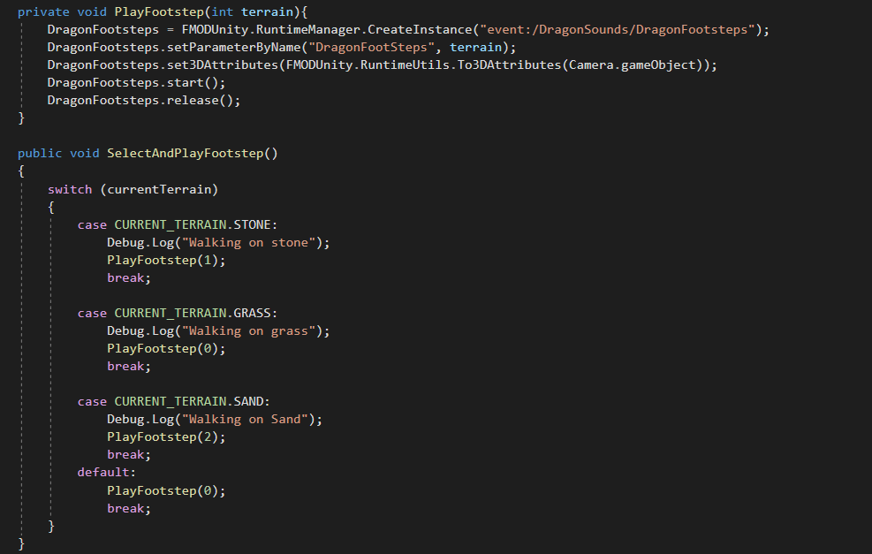
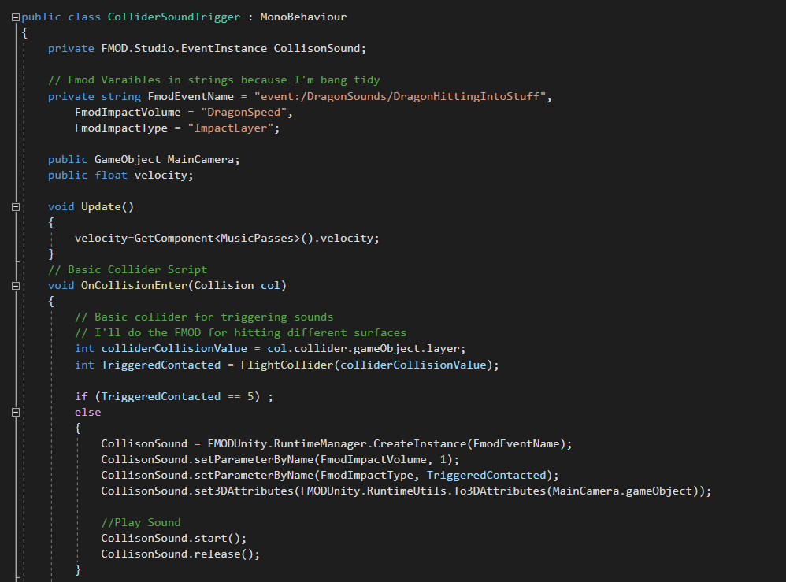
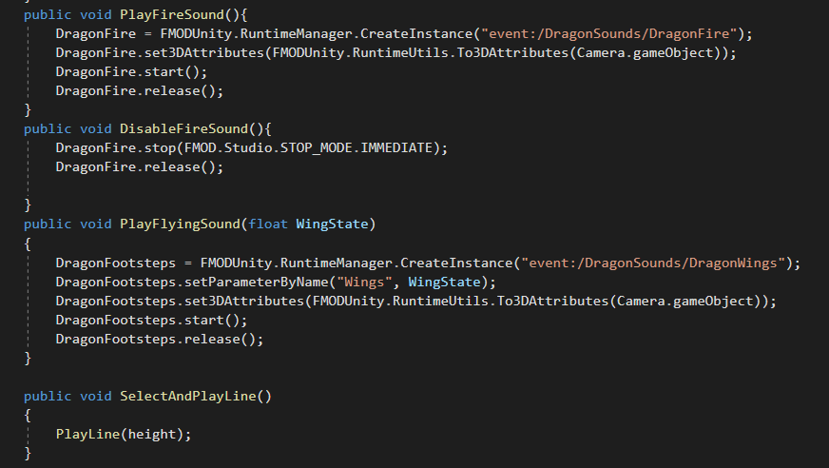
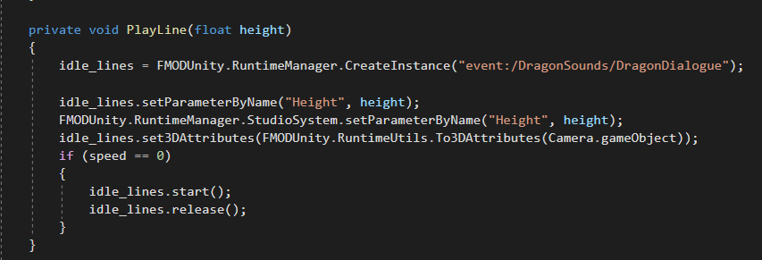
Notes:
Needs more Eggs

Slide 19
Honorable Mentions
Not every sound could be added due to time.
Riadh Lastname as the Dragon, Little Boy, Michael Gira, brummie sales person, Dr Nic, and a questionable accent.
Conor Yarrington as the Turnip Lady.
Ellice’s harddrive of unused audio.
Kris’s harddrive of unused audio.
David’s harddrive of unused audio.
Weapons such as: Bow and Arrow, War Hammer, Bombs, Swords for NPC.

